Slide 1
Facilitator Guide
FACILITATOR GUIDE ONLY
Read the team leader facilitation guide.
Organise and facilitate the workshop:
Think cross-functionally when scheduling your workshop
Share the company vision & strategy for context
Co create the mission & values then submit results
Play the card game
Get teams to craft a mission statement

Slide 2
Prepare your resources in advance
FACILITATOR GUIDE ONLY
Slide deck with a talk track for consistency
Values playing cards
Process to gather the missions & card game inputs
Group energisers to run at the start of the workshop (see supporting resources slides)
Budget for refreshments/printing etc.
Co-facilitation support (recommend minimum 2 facilitators and more for groups of 50+)

Slide 3
[Company name]
Mission and values workshop
Add date, team

Slide 4
Table of Content
Agenda
Purpose of today’s workshop
What’s new? Introducing our:
Vision
Strategy
Values
Mission
Our task today
Share your reflections on today’s tasks
Supporting resources

Slide 5
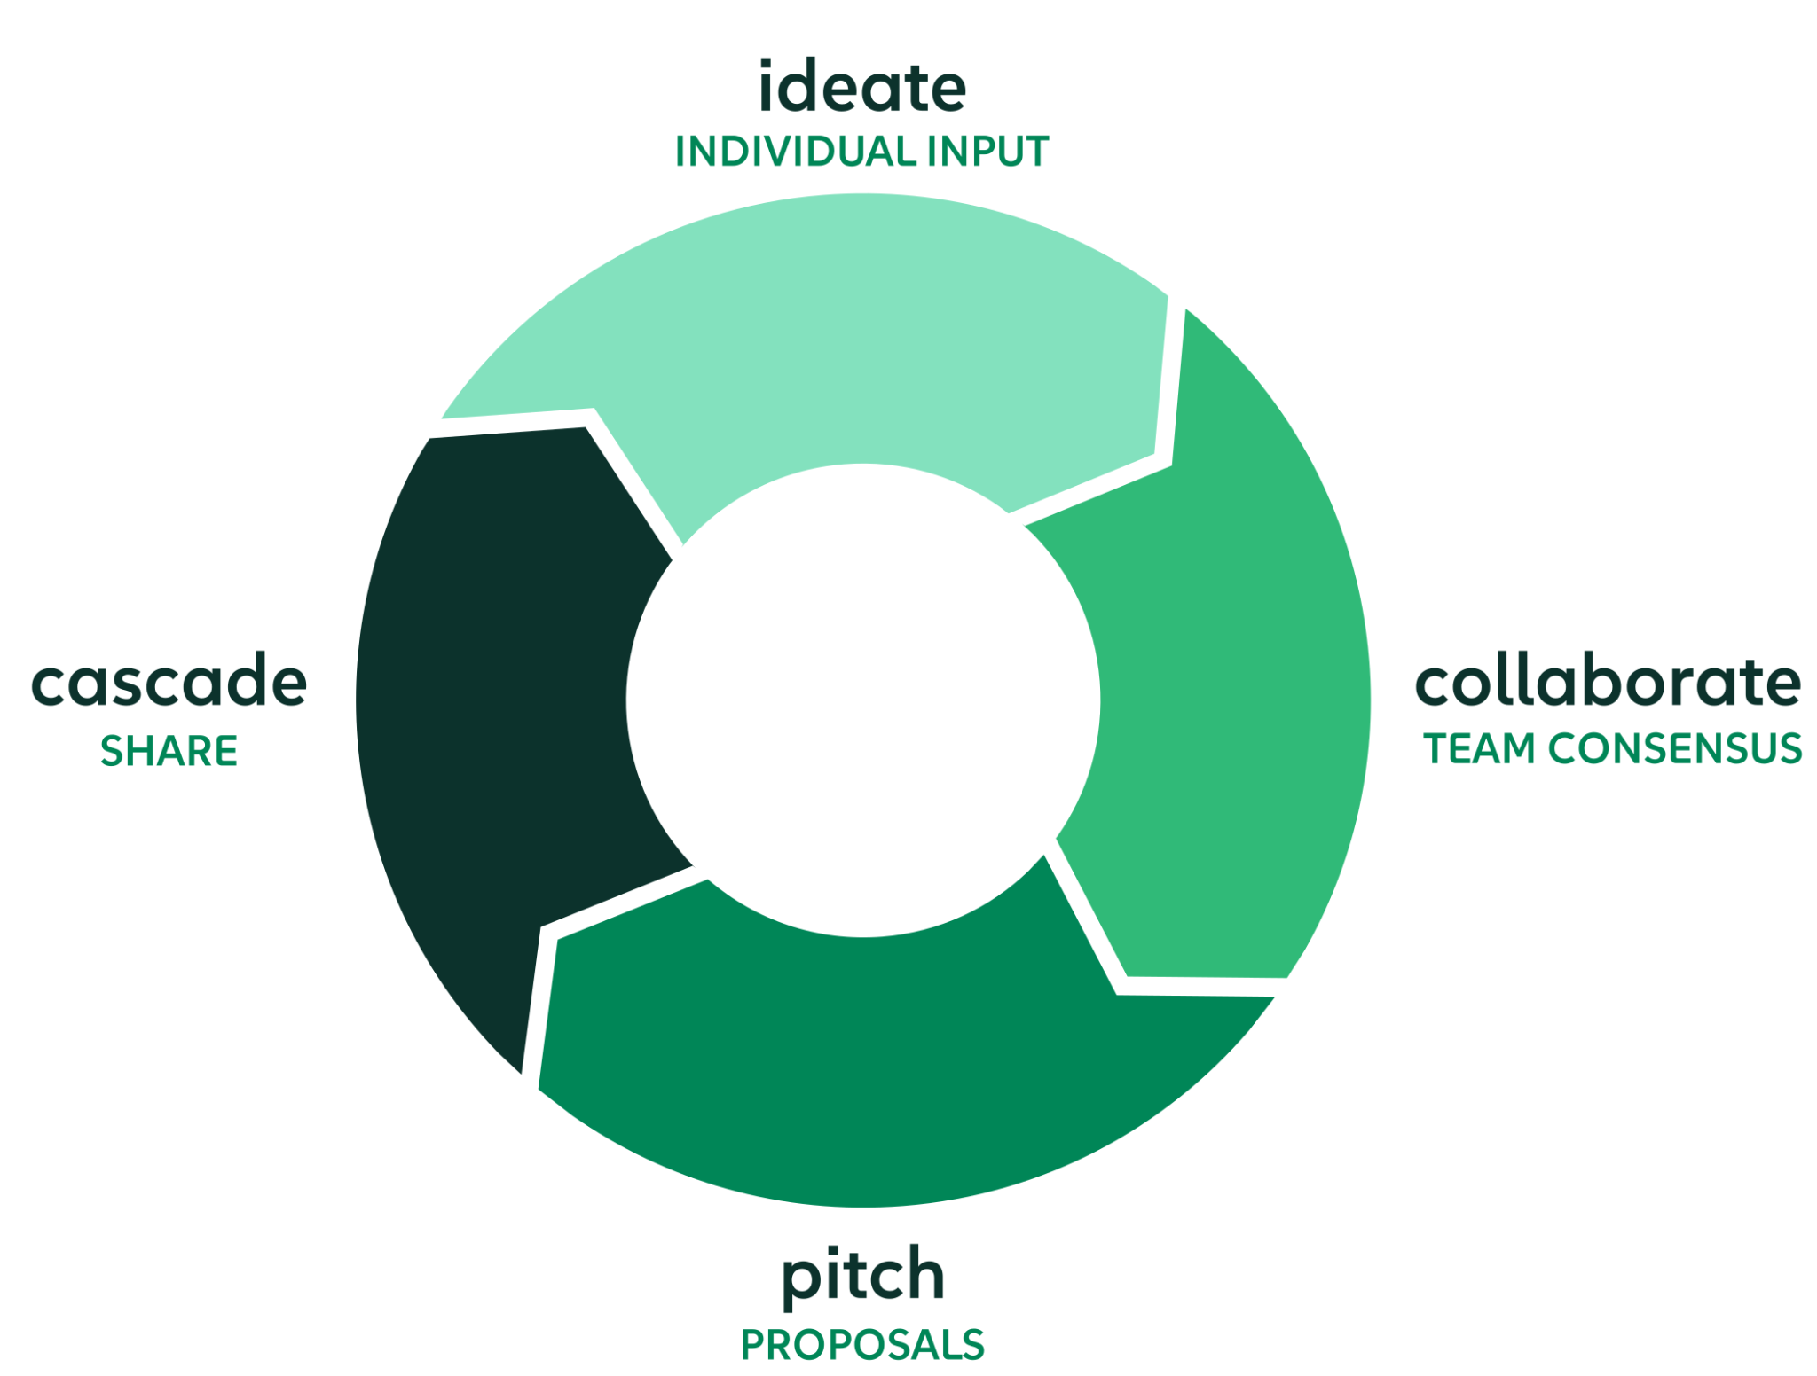
Purpose of today’s workshop
SHARE & ALIGN ON
mission and values
A whole-company discovery process

Slide 6
What’s new?
Your company vision and strategy

Slide 7
What is a vision?

Slide 8


Slide 9
Here is ours

Slide 10
Add your
vision here

Slide 11
Our task today

Slide 12
A whole-company discovery process
Ideation
Collaboration
Presentation
Cascade
Individual input
Group sessions
TODAY!
Proposals
Local sessions

Slide 13
Our values

Slide 14
Card Game
In-person or online
Bold
Honest
Proud
Expert

Slide 15
In person version of values activity
Part 1: Create 4 piles with your cards - 10 minutes
Uniquely SUSE Unique or SUSE does it better
Table stakes Required by the infrastructure space
Never SUSE SUSE would never be this
Discard Fits nowhere else

Slide 16
In person version of values activity
Part 2: Build consensus - 20 minutes
1. Label and set aside: Table-Stakes, Never SUSE, and Discard
2. Place Uniquely SUSE cards face up on the table
3. Debate and vote for your top 3
4. Rank your table’s top 3 words

Slide 17
Online version of values activity
Activity 1:
You have 20 minutes to sort through 72 cards which each has a word on them. Your task is to allocate each word to one of four categories.
Activity 2:
You have 10 minutes to discuss, agree and rank your top 3 words in the ‘Uniquely SUSE’ category.
You will be sent to breakout groups to complete 2 activities in 30 mins.
Open this link, download and save a copy.
Allocate somebody to capture your decisions on the slides.
Allocate a timekeeper in your group.
Bold
Honest
Proud
Expert

Slide 18
2.Our mission

Slide 19
A vision and mission come as a pair
Vision
Mission
A mission is the role we wish to play to reach our vision.
A vision is a picture of success at a particular time in the future. Something that doesn’t change every time the market or mood shifts.

Slide 20
Food for thought:
Here is what a few other familiar companies have come up with

Slide 21

Vision
Mission
To inspire the world with our innovative technologies, products, and design that enrich people’s lives and contribute to social prosperity by creating a new future.
We will devote our human resources and technology to create superior products and services, thereby contributing to a better global society.

Slide 22

Vision
Mission
To organize the world’s information and make it universally accessible and useful.
To provide access to the world’s information in one click.

Slide 23

Vision
Mission
To connect the world’s professionals to make them more productive and successful.
To create economic opportunity for every member of the global workforce.

Slide 24

Your mission is to write a mission for [company name]
Split into groups.
Task: 30 minutes to draft a mission statement using guidelines on next slides.
Agree a spokesperson to present your mission to the group.
Capture all submissions on a Google Form (or similar).

Slide 25
Mission Statement
Group Presentations

Slide 26
Next Steps
Add indicative timeline for the data collection, analysis and launch.

Slide 27
Share your reflections on the tasks

Slide 28
THANK YOU

Slide 29
Supporting Resources

Slide 30
Energizers

Slide 31
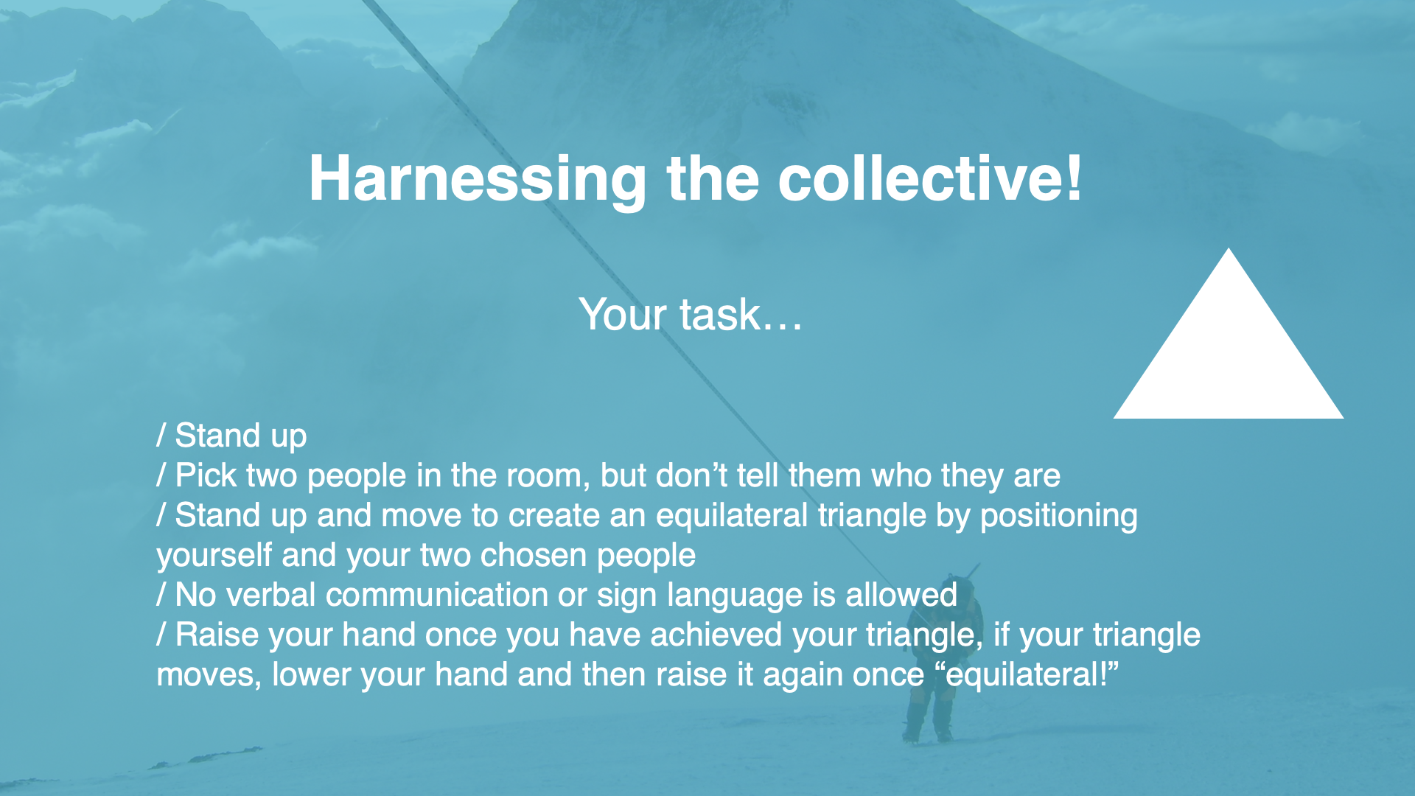

Slide 32


Slide 33
Energizer: Speed ball!
Rules of play:
the ball must start and finish with the same person.
you cannot throw the ball to the person next to you.
everyone must throw and catch the ball once (except the starter/ finisher)
the ball must be passed through the air (not hand to hand).
if you drop the ball it is a DNF!
you will have three opportunities to improve you time!

